Slide 1
Salesforce Enablement Program : Lightning (Aura & Web Components)

Slide 2
Topics
Component IDs’
Rendering life cycle
Inline style sheets
What are events in Lightning framework
Types of Events
Component events
Phases of component events
Application events
Phases of application events

Slide 3
Component IDs
A component ID is a point of reference to a specific component
A component has two types of IDs: a local ID and a global ID
Local ID: A local ID is an ID that is only scoped to the component. A local ID is often unique but it’s not required to be unique.
Syntax : <lightning:button aura:id="button1" label="button1"/>
Use Component.find(“”) to retrieve the component
Returns different types depending on the result
Global ID: Every component has a unique globalId, which is the generated runtime-unique ID of the component instance. A global ID (1) is not guaranteed to be the same beyond the lifetime of a component, so it should never be relied on. A global ID can be useful to differentiate between multiple instances of a component or for debugging purposes.

Slide 4
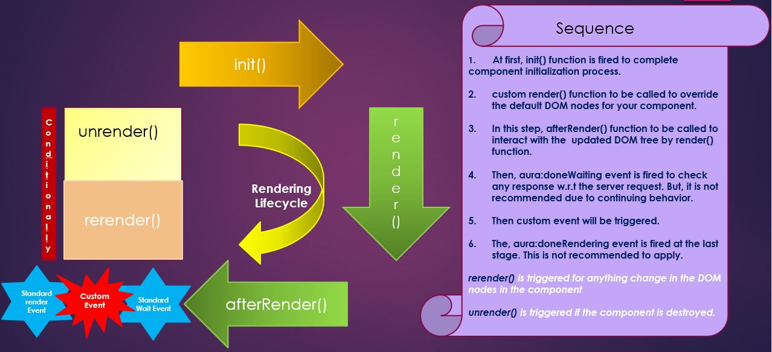
Rendering lifecycle

Slide 5
Styling in Aura components
We can add style to a component to enhance the view of end user using styling. Lightning aura frameworks supports three ways of how to add styling to your components
The three ways are :
Use Inline CSS
By external CSS file.
By create style tab in component bundle.

Slide 6
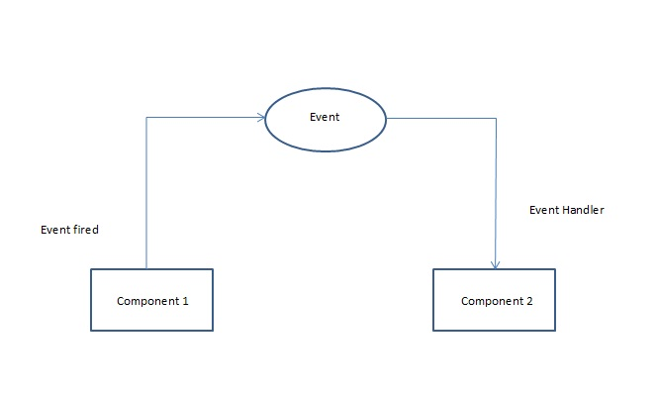
What are events?
An event is a phenomenon that happens/occurs due a particular action
Lightning framework is based on event-driven architecture which allows to communicate between different events. Lightning events are fired from JavaScript controller actions that are triggered by a user interacting with the user interface.
Simple events in Javascript are onChange, onClick, onPageLoad
They establish a communication medium across components on a web page
They transfer data from Source component to destination/multiple destinations using attributes

Slide 7
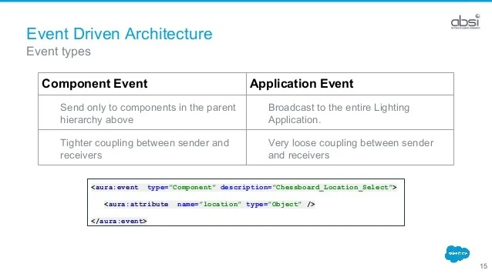
Types of Events
Component Events
Application Events

Slide 8
Component Events
A component event is fired from an instance of a component. A component event can be handled by the component that fired the event or by a component in the containment hierarchy that receives the event.
They are best used when a communication is needed between related components or contained components like Parent child
Syntax:

Slide 9
Phases of Component events
Bubble phase:
Event propagates from source to application root in bottom to top fashion.
Capture phase:
Event propagates from Application root to Source in top to bottom fashion.
Default phase for component events is Bubble phase

Slide 10
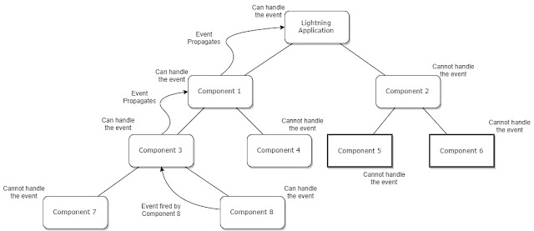
Component event propagation:

Slide 11
Time for hands on..!

Slide 12
Application events:
Application events follow a traditional publish-subscribe model.
An application event is fired from an instance of a component.
All components that provide a handler for the event are notified.
Broadcasting events
Syntax:

Slide 13
Phases of Application events
Bubble:
Event propagates from source to application root in bottom up fashion.
Capture:
Event propagates from application root to source in top down fashion.
Default:
Event handlers are invoked in a non-deterministic order from the root node through its subtree. The default phase doesn’t have the same propagation rules related to component hierarchy as the capture and bubble phases.

Slide 14
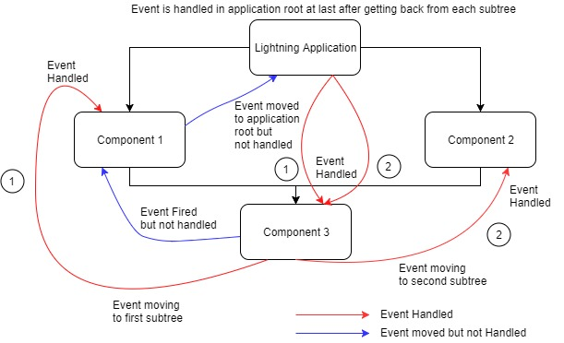
Application Event Propagation

Slide 15
Points to remember
Order of execution for component event handlers is Capture > Bubble
Order of execution of Application event handlers is Capture> Bubble> Default
If event.stopPropagation(); is called in the capture phase, no event is called further in the capture phase or in bubble phase and if it is called in bubble phase, no event is called further in this phase.
If event.stopPropagation(); is called by any handler before the default phase that component consisting of the handler in which this method is called becomes the root node for the default phase.

Slide 16
References:
https://developer.salesforce.com/docs/atlas.en-us.lightning.meta/lightning/components_ids.htm
https://kloudrac.com/blog/styling-in-lightning-component-through-css/
https://www.sfdcstop.com/2018/03/events-in-salesforce-lightning.html
https://developer.salesforce.com/docs/atlas.en-us.lightning.meta/lightning/events_intro.htm
Trailhead:
https://trailhead.salesforce.com/content/learn/modules/lex_dev_lc_basics/lex_dev_lc_basics_events

